Slide 1
Quality Foundations Playbook TEC- 406-160017
August 10th, 2020
Global Operations

Slide 2



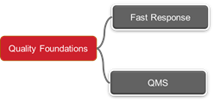

Using the Quality Foundations Playbook – What do the Icons Mean?
Fast Response
Where this Icon is visible refers to a Tip / help
Quality Foundations
Where this Icon is visible refers to a special Note on the subject
QMS
Click on Buttons to jump to that topic
Where this Icon is visible refers to a point of information on the subject, linking to additional Playbooks or Training materials for example
Click on the agenda icon to return to the agenda for the current phase
Click on the Chart Icon to return to the main page
Return to Agenda

Slide 3
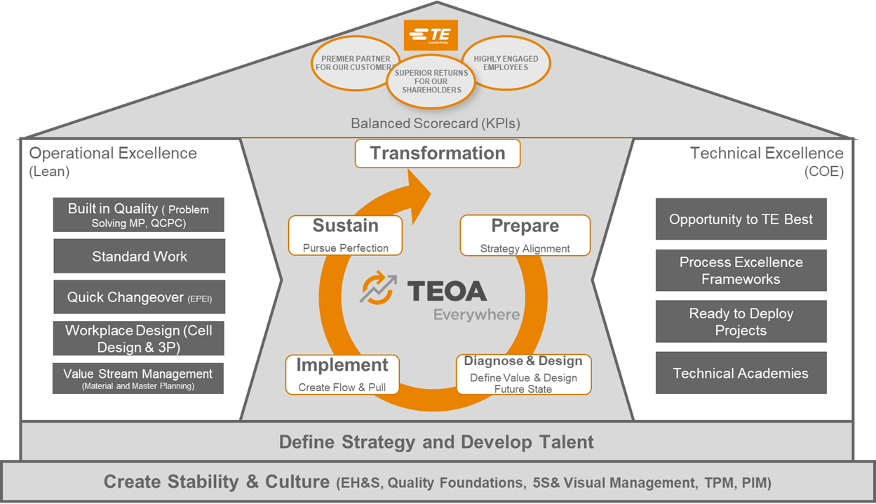
Quality Foundations Introduction
Quality Foundations is a tool in the Create Stability section of the TEOA House and is comprised of two sub tools, Fast Response & QMS.
Fast Response
Quality Foundations
QMS
Note: Click on the Buttons above to quickly access the topic
Notes:
QMS is a new addition to the TEOA tool set which establishes a link to quality right at the beginning of a TEOA site deployment.

Slide 4
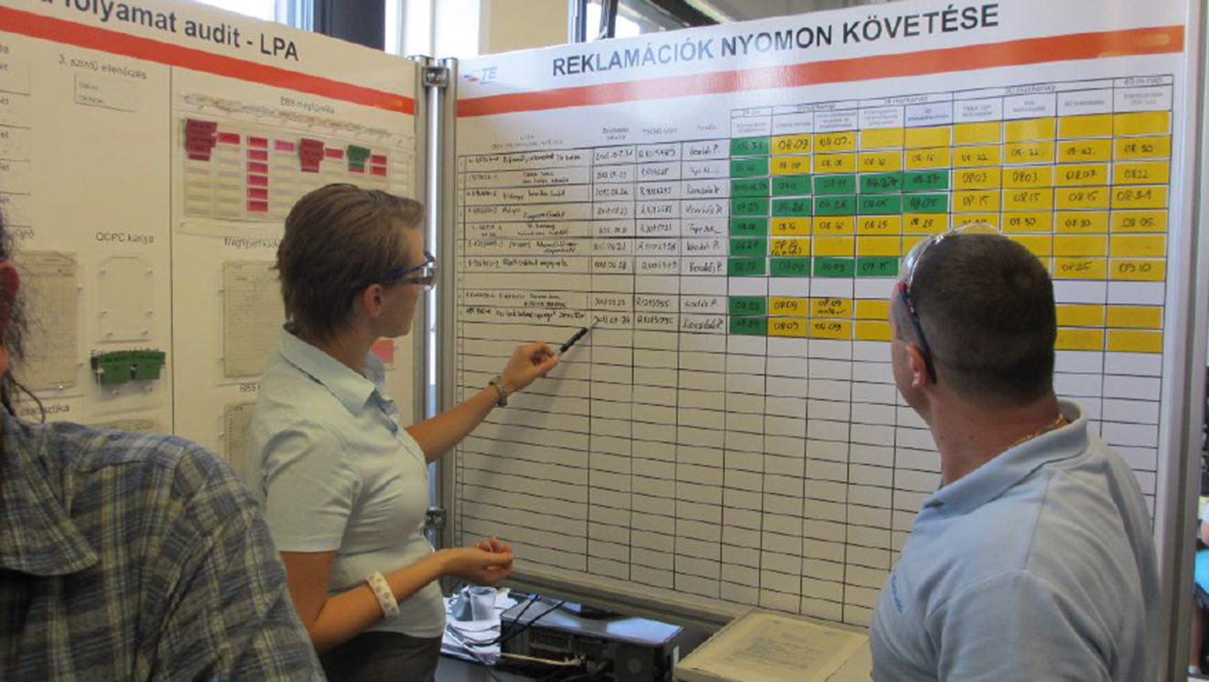
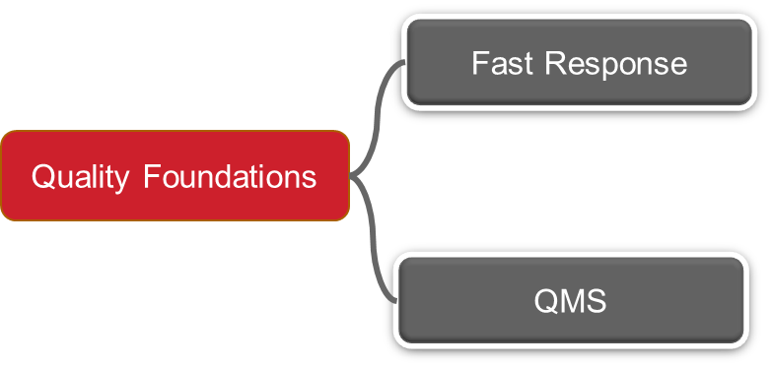
Fast Response
A standardized process that focuses on the speed and effectiveness of our response to quality failures or concerns

Slide 5
Fast Response Overview
Definition
What is the Purpose
Why Use it
How to Implement Fast Response
Best Practice Examples
BDP repository on Fast Response
Questions to Consider
In this Playbook:
A definition of what is Fast Response
What is the Purpose of Fast Response
Why use Fast Response
How to implement Fast Response
Training materials
Best practice examples
Note: Click on the links above to quickly access the topic

Slide 6
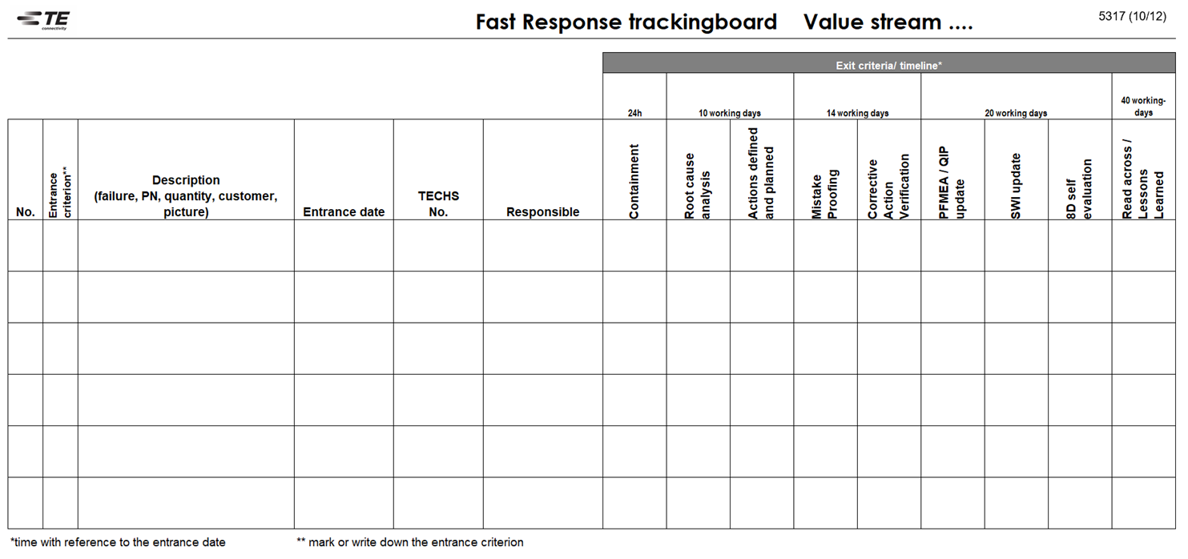
1. Fast Response Definition
A standardized process that focuses on the speed and effectiveness of our response to quality failures or concerns.
It reflects the expected implementation of the TE complaint handling process as described in TEC-1002.
It has a focus on shop floor execution, with engagement of cross-functional teams throughout the different steps of the process.
It includes the systemic lessons learned activity, to ensure that defined solutions are sustainably implemented, not only in the area that is subject of the quality occurrence, but also throughout the site and across sites.
It includes in a “next step” the aspect of consolidation of lessons learned to a specific topic.
Manage the growing TE expertise on how to avoid failures from occurring and escaping, through use of FMEA and Lessons Learned repository.
The template above is the standard Fast Response tracking board 5317
Return to Agenda

Slide 7
2. What is the Purpose of Fast Response
The purpose of Fast Response is to ensure a timely and effective problem-solving process for identified quality issues.
This can be triggered from customer notifications, but equally applies to identified quality risks from internal manufacturing processes or from within TE delivery.
The use of this tool is aiming for:
Speed: cost of poor quality is rapidly increasing if quality problems are not timely stopped at the source.
Effectiveness: re-occurrence of quality problems are severely rated by our customers and a reason for escalation.
Prevention: Lessons learned that contribute to an increasing systemic robustness against Quality failures
Know how increase: consolidation of Lessons Learned using master FMEA's for TE's core processes, connected with Lessons Learned repositories for re-occurring failure types.
Return to Agenda

Slide 8
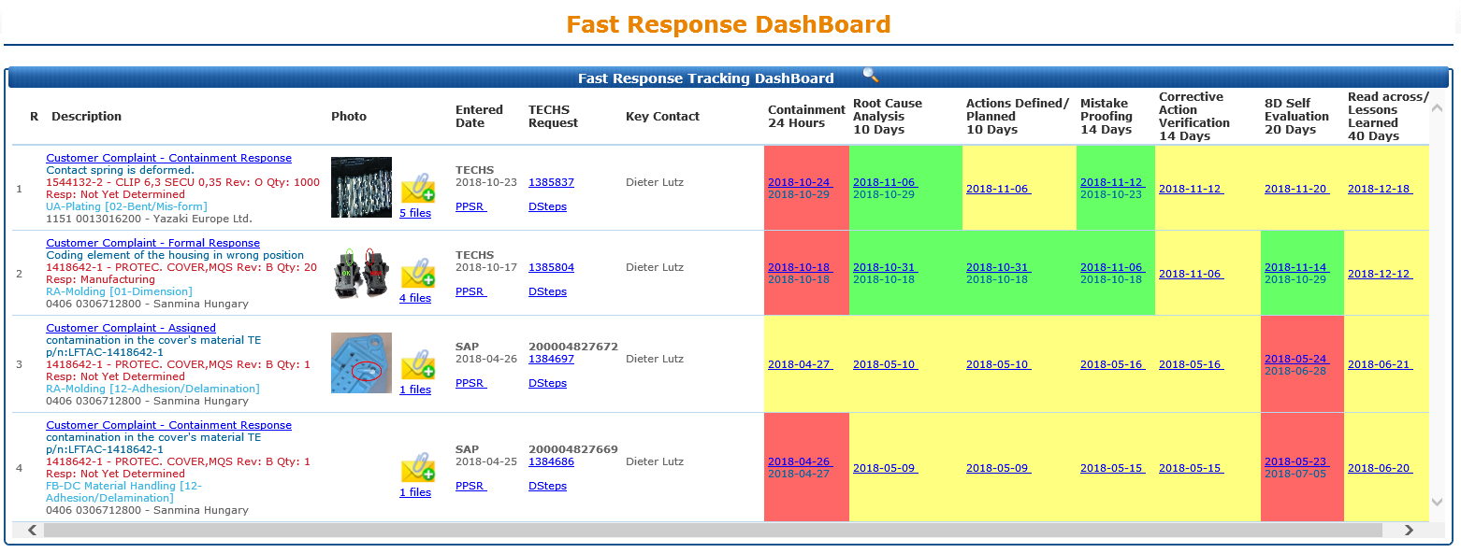
3. Why Use Fast Response?
The Fast Response process engages all functions that are connected to the identified quality issue, as soon as the issue is identified, and until it has been systemically closed.
It has a high shop floor visibility and presence with the tools provided.
Digital Fast Response Dashboard Example
Return to Agenda

Slide 9



4. How to Implement Fast Response
Prepare
The Site Leadership teams have completed Fast Response training, so they understand their role in coaching and confirming on the effectiveness of the teams involved. Cross functional teams are trained and engaged in problem solving activities.
See also Built in Quality (TEC-406-160021) for Problem Solving methodologies.
Refer to TEOA 122 Fast Response training materials
Additional training on LEARN@TE APL 8D Certification - 8D Module
Built in Quality (TEC-406-160021)
Return to Agenda

Slide 10
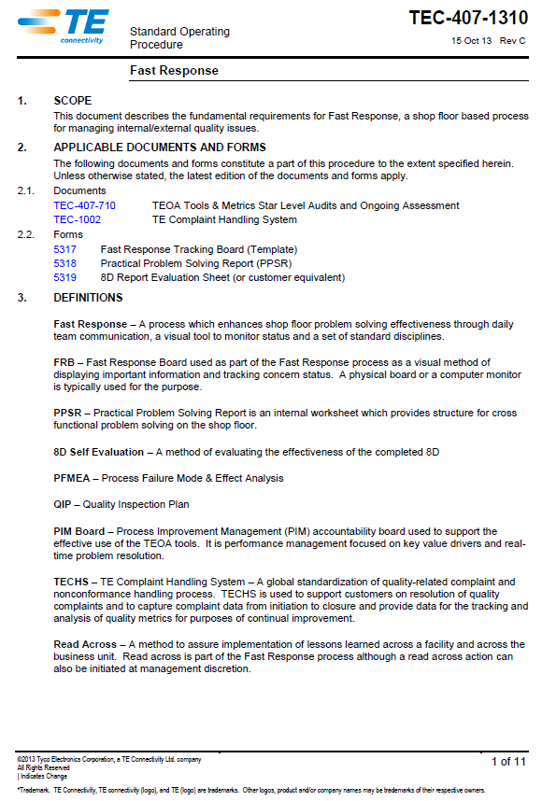
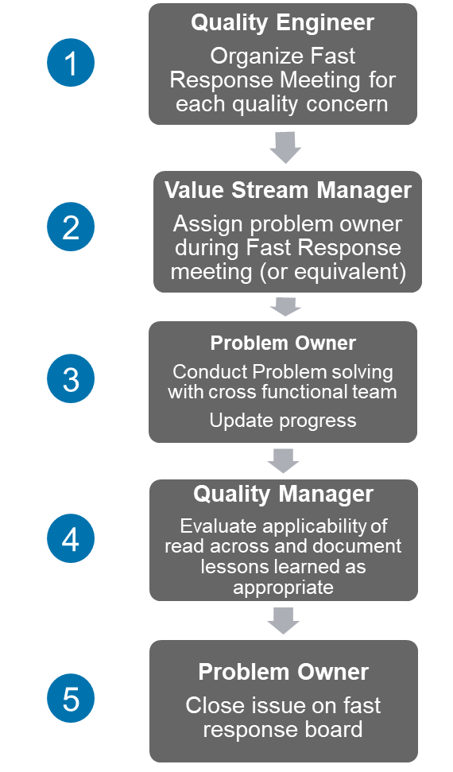
4. How to Implement Fast Response.
Diagnose and Design
Using TEC-407-1310 Fast Response SOP to establish the Fast response process.
Establish the Fast Response Board to support the process.
This can be a physical board or an electronic equivalent.
Shop floor problem solving utilizes standardized tools Practical Problem Solving Report (PPSR or equivalent). Ensure this tool is available.
TEC-407-1310 document describes the fundamental requirements for Fast Response
Return to Agenda

Slide 11
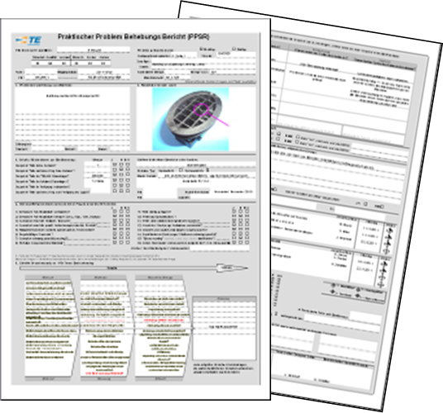
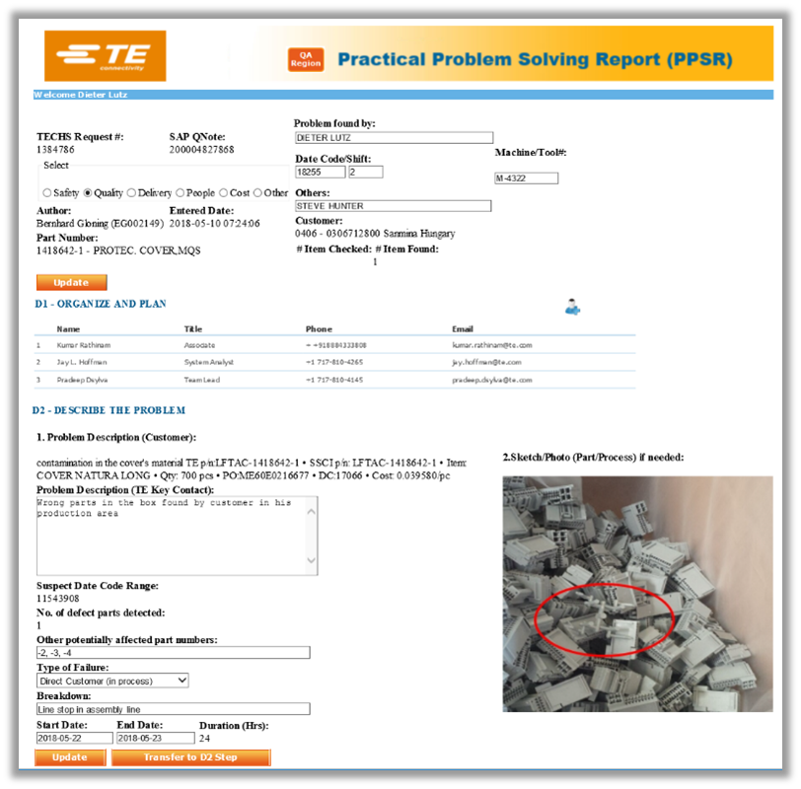
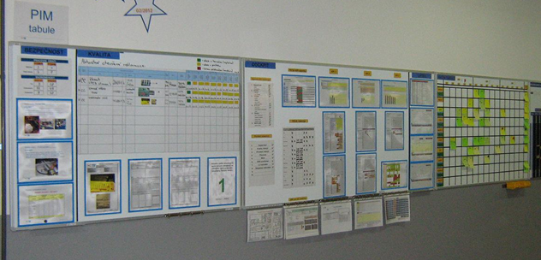
4. How to Implement Fast Response
Implement
Fast response board is integrated into the PIM process and reviewed as part of the daily PIM meeting.
Cross functional participation is in place, such as from Manufacturing, Engineering, Quality, ….
Prioritized* external customer, intercompany & internal quality complaints / concerns between departments/value streams are captured and managed via Fast Response process, proportional to the potential impact. *Prioritized, based on impact assessment for safety, repetition of occurrence, cost, customer requirement , ECE
Practical Problem-Solving Report is made available in TECHS for transparency and history.
Example of Manual PPSR
PIM Board
Fast Response Board
PPSR’s
Practical Problem Solving Report
Example of digital PPSR from TECHs
Example of Fast Response Integrated into PIM Process
Return to Agenda

Slide 12
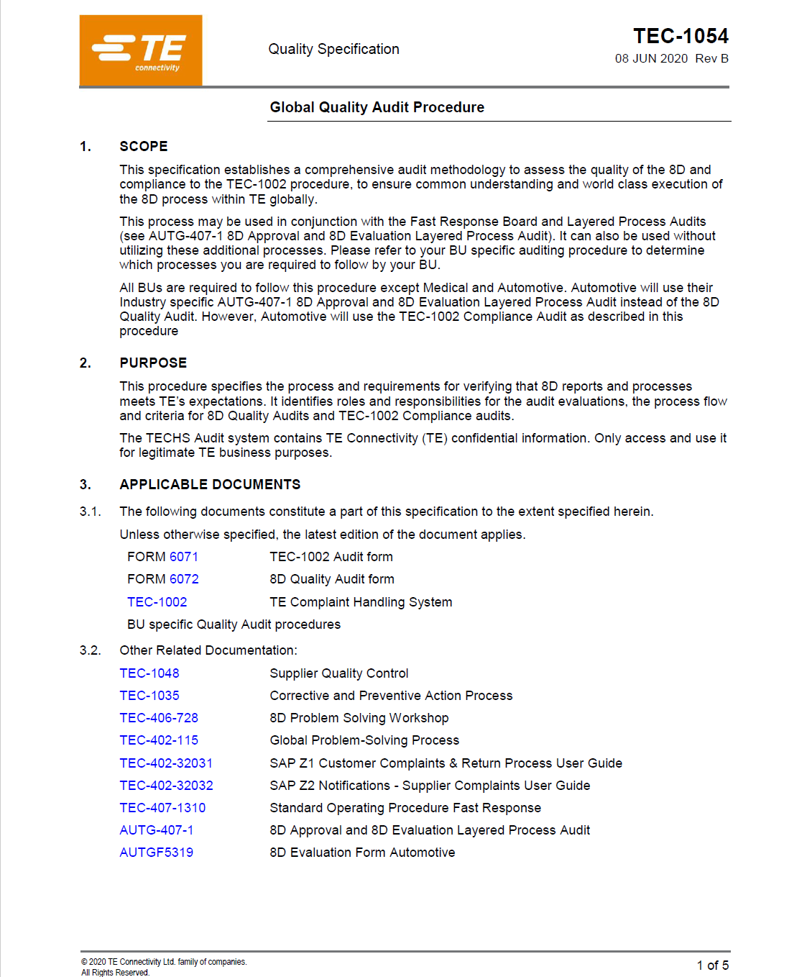
4. How to Implement Fast Response
Sustain​
8D self-evaluations are conducted and score an average of >80%. ​Ref TEC-1054 for monitoring of compliance and team coaching.
Assessment dashboard in TECHs is used for continuous improvement on the 8D scoring.
Read across / lessons learned is considered and implemented​. - Internal, the Value Stream owner is assigned the responsibility for implementation, tracking via local plant methods. (exp. PIM,..)​ - External, the Quality Manager will submit the potential read across actions to the regional quality leader for review and disposition.​
FMEA tool is used for know-how management on failure modes, for future risk assessments . Connection is made between master FMEA's and consolidated lessons Learned for main failure modes. ​
TEC-1054 document describes comprehensive audit methodology to assess the quality of the 8D
Return to Agenda

Slide 13
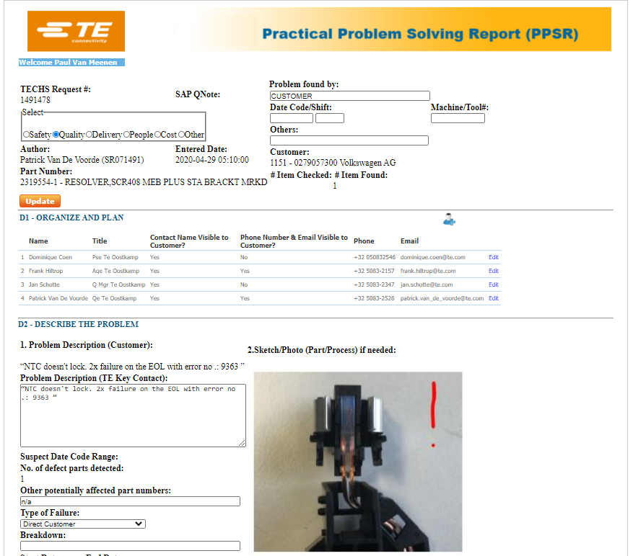
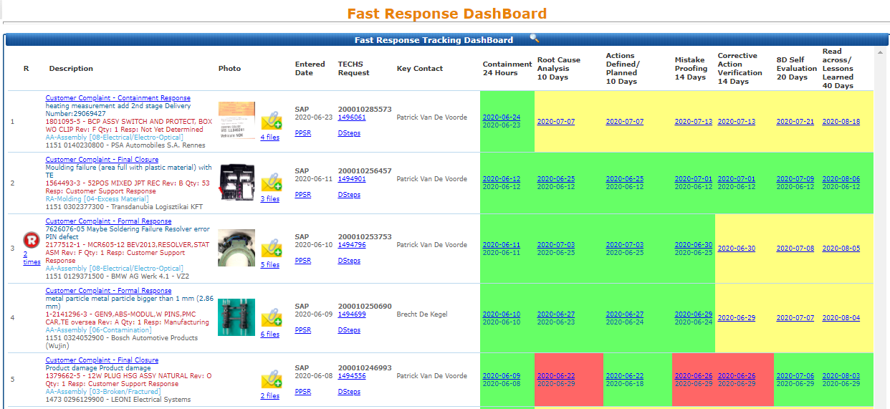
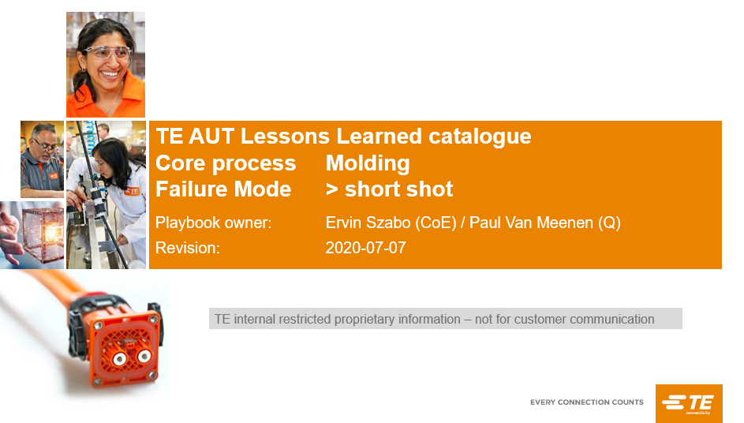
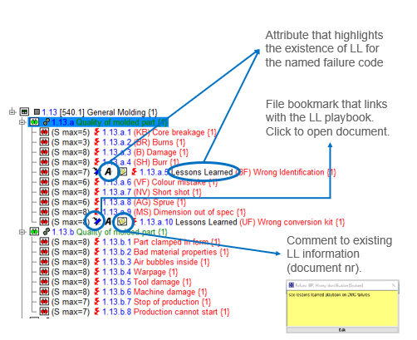
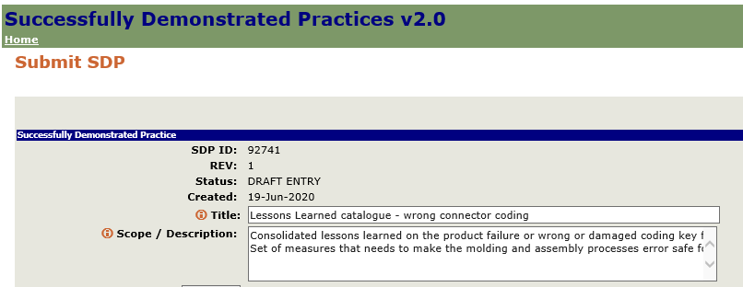
5. Fast Response Best Practice Examples
Techs Fast Response Dashboard tracking
Consolidated lessons Learned on occurrence and non-detection, related to a specific failure mode
PPSR in Techs
Read Across through SDP repository
Integration in master FMEA
Return to Agenda

Slide 14

6. Access to Shared Best Practices
Click here to search for Fast Response SDPs
Return to Agenda

Slide 15
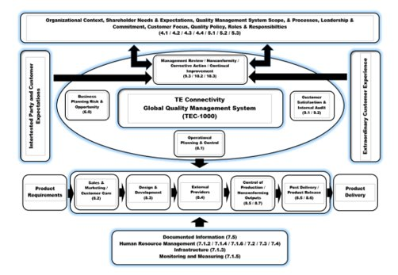
QMS
The basis for analysing customer requirements, defining the processes that contribute to the achievement of a product or service that is acceptable to the customer, and provisions for keeping these processes in control.

Slide 16

1. QMS Definition
The TE Quality Management System provides the basis for analysing customer requirements, defining the processes that contribute to the achievement of a product or service that is acceptable to the customer, and provisions for keeping these processes in control.
Expectations and requirements are written in the corporate document TEC-1000 .
QMS is a fundamental element of TEOA.
QMS is a process-based management system, that combines the requirements from the customer and interested parties in the different steps in the process flow between customer requirements and sustained delivery.
It shows expectations, sequence and interaction for each of the different steps in the flow.
Applicable quality management system processes include order entry, design and development engineering, purchasing, production, warehousing, calibration, receiving inspection, and shipping.
Equally included are International industry standards and regulations as applicable to the BU.
Refer to TEC-1000 for details regarding QMS.
Additional training on LEARN@TE Global Quality Management System (QMS)-An Introduction

Slide 17

Quality Foundations - Improvement Over time
Prepare
Diagnose & Design
Implement
Sustain
The cycles surrounding Quality Foundations continue to mature as the site evolves over time.
See Diagnostic Questions on next page to help understand the sites level
Prepare
Diagnose & Design
Implement
Sustain
Cycles of Improvement
Prepare
Diagnose & Design
Implement
Sustain
Site Quality Foundations Path
Note
There that is no formal Assessment for this tool at Star level 3,4 or 5, however the expectation is for the cycles of Improvement to continue as the site matures.
Prepare
Diagnose & Design
Implement
Sustain
Stabilised
Prepare
Diagnose & Design
Implement
Sustain
Beginning
Time
Return to Agenda

Slide 18
Questions to Consider around Quality Foundations Deployment
Beginning
Have Site leadership teams completed training on Fast Response & QMS?
Have all employees completed SF training to have a understanding of Fast Response and QMS?
Are Customer complaints fulfilling the entrance criteria captured and managed via fast response process TEC-407-1310?
Are all external customer complaints captured and managed via fast response process?
Stabilised
Is the Shop floor utilizing standardized problem solving tools (PPSR or equivalent)
Are all external customer complaints and repeated intercompany complaints are captured and managed via fast response process?
Is the Fast response board review integrated into the PIM process?
Are the 8D self evaluations on the FRB board score achieving an average of 70% or higher using the TEC-1054 document?
Is the assessment dashboard in Techs used for continuous improvement on the 8D scoring?
Are read across/lessons learned considered and implemented within the plant where appropriate?
Cycles of Improvement
The expectation is the cycles of improvements will continue as the site matures.
Return to Agenda

